Slide 1
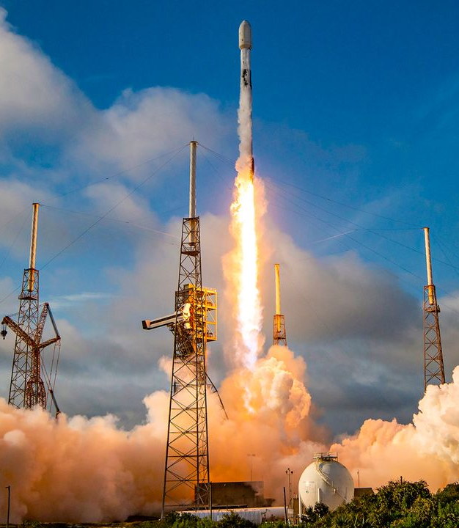
Data and SpaceX: Insights on Rockets and their Launches
Ryan Wm. Greene
03/15/2024

Slide 2
Outline
Executive Summary
Introduction & Goal
Methodologies
Data Collection
Data Wrangling
EDA with SQL & Visualizations
Machine Learning
Conclusions
Folium & Plotly

Slide 3

Executive Summary
Methodologies for…
Data Collection
Data Wrangling
Data Analysis
Folium & Plotly Visualizations
ML Predictions and Insights
Results
Screenshots
Final Insights and Takeaways

Slide 4
Introduction & Goal
Instead of using rocket science to determine if the first stage will land successfully, you will train a machine learning model and use public information to predict if SpaceX will reuse the first stage.
The commercial space age is here, companies are making space travel affordable for everyone. Virgin Galactic is providing suborbital spaceflights. Rocket Lab is a small satellite provider. Blue Origin manufactures sub-orbital and orbital reusable rockets. Perhaps the most successful is SpaceX. SpaceX’s accomplishments include:
Sending spacecraft to the International Space Station.
Starlink, a satellite internet constellation providing satellite Internet access.
Sending manned missions to Space.
One reason SpaceX can do this is the rocket launches are relatively inexpensive. SpaceX advertises Falcon 9 rocket launches on its website with a cost of 62 million dollars; other providers cost upwards of 165 million dollars each, much of the savings is because SpaceX can reuse the first stage. Therefore, if we can determine if the first stage will land, we can determine the cost of a launch.

Slide 5
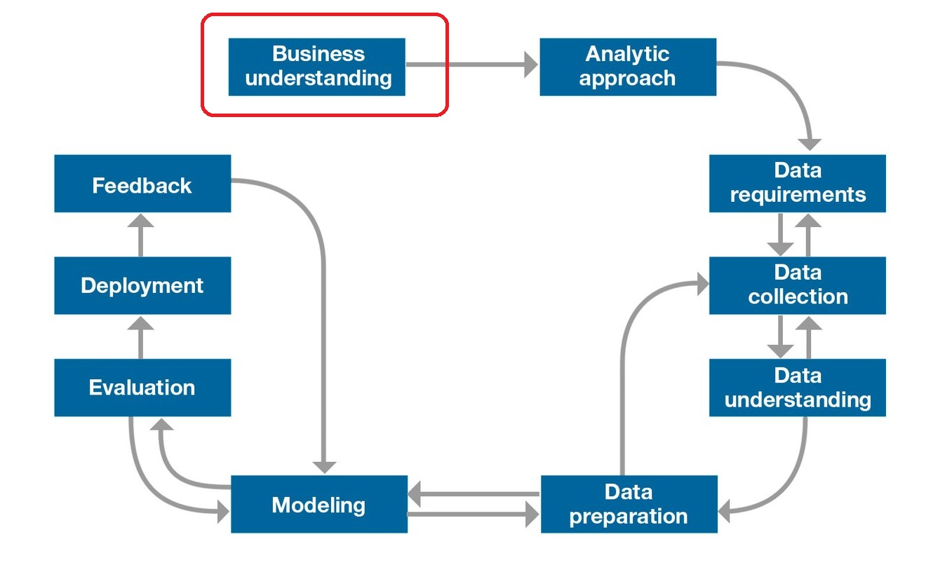
Methodologies

Slide 6
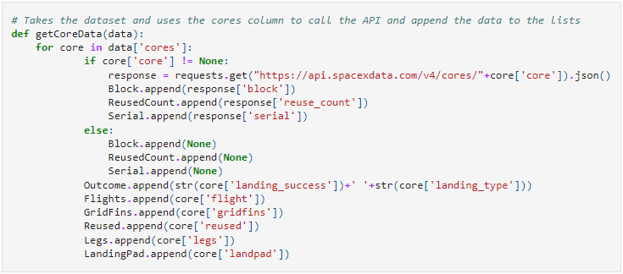
Data Collection – SpaceX Api
By utilizing Space X’s API we can call & response past rocket launches and get a huge JSON of data. We’re able to then parse through, append relevant information to our data frame (ie. launch pads, booster versions) and use average values to fill in for empty values (namely in the case of payload mass)

Slide 7
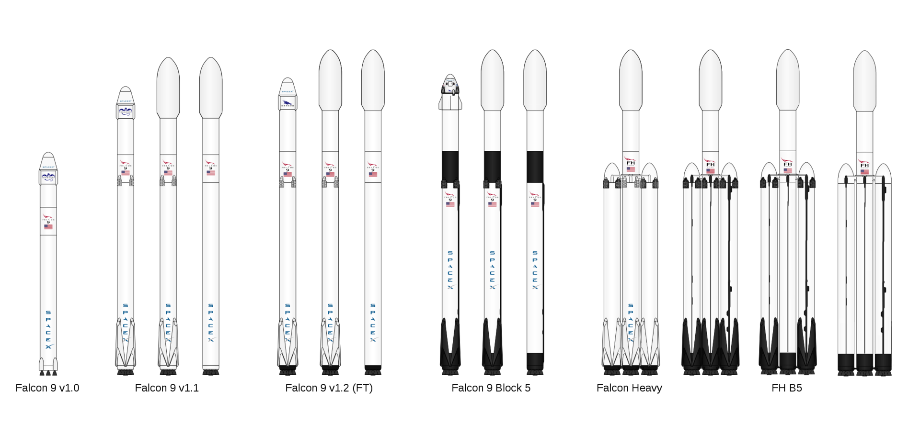
Data Collection – Webscrapping Wiki
By utilizing BeautifulSoup and making requests from the SpaceX wiki page on launches, we’re able to utilize the neatly formatted tables that exist there.
Once requested and souped, we're able to use the HTML tags to break the table apart and assign tags as needed to our data frame.

Slide 8
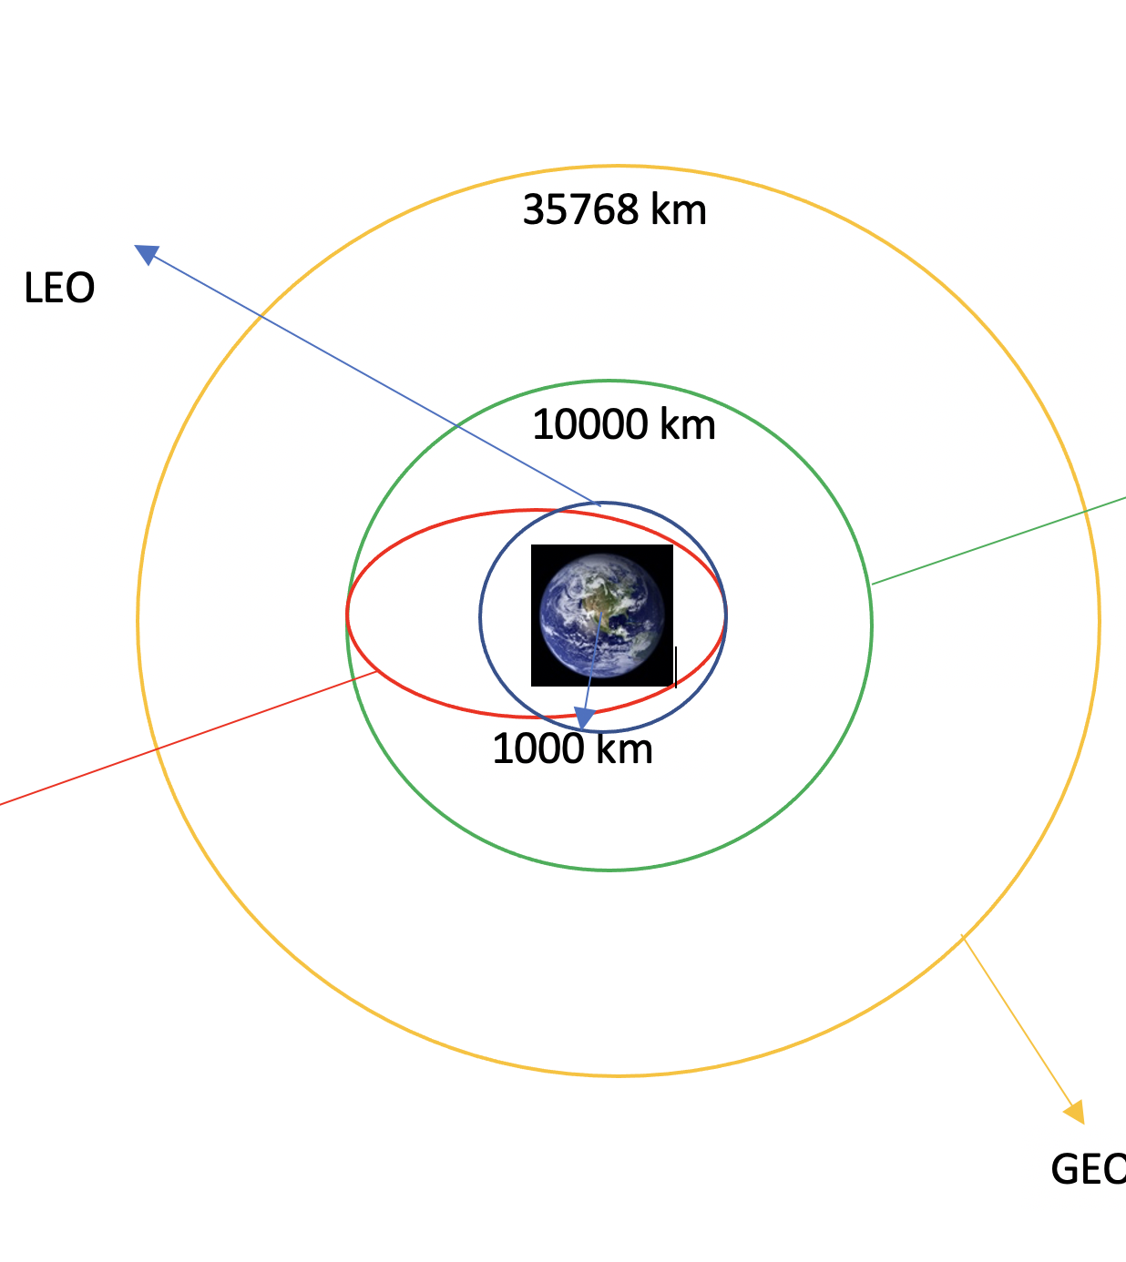
Data Wrangling
Our data wrangling sets us on course for success. We start by identifying missing values, getting our data types, and identifying orbits and outcomes.
By utilizing the outcomes column, which has eight different outcomes, we’re able to create a ‘Class’ column with a Boolean value: we make a ‘Success or Fail’ column from a more complex column.
By doing so, we’re able to then identify average success rates.

Slide 9
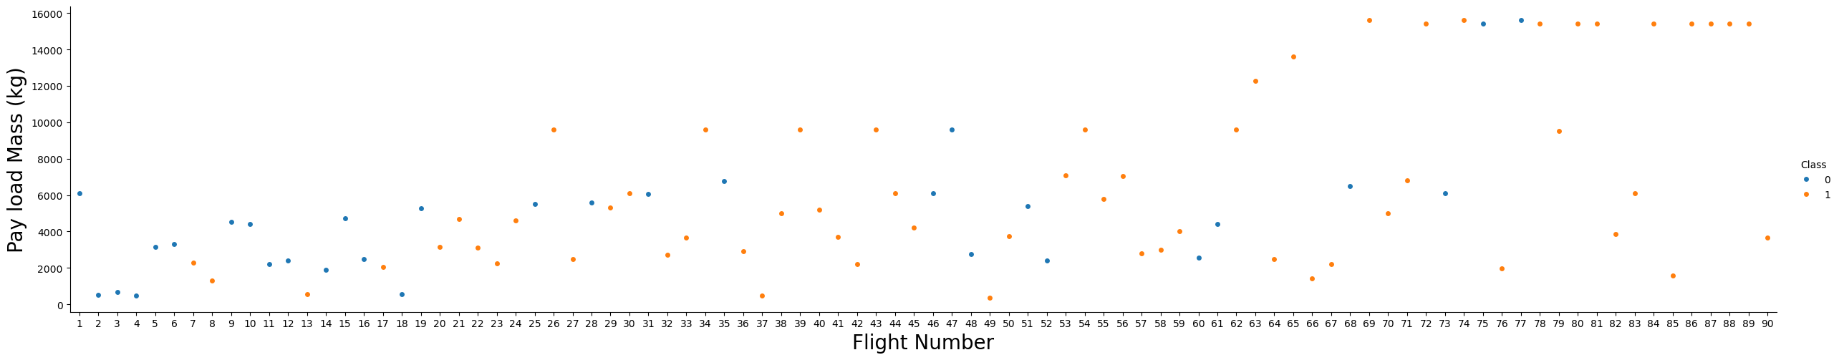
EDA with Visualizations
Our dataset has a lot of interesting relationships worth visualizing. While all of them will be shown later, the viz shown displays flights by payload mass, and whether they succeeded or not.
We were able to produce visualizations utilizing outcome/class, payload mass, launch sites, orbit, and average success over measurements such as year.

Slide 10
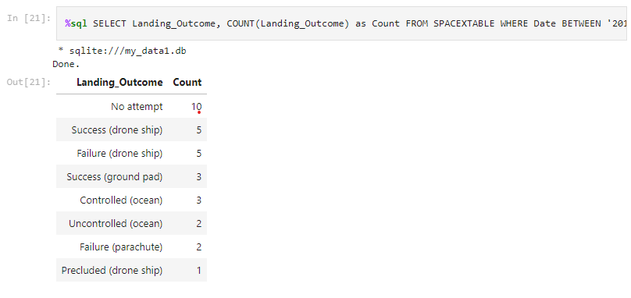
EDA with SQL
In Jupyter Notebook we use SQLAlchemy, connect to a database, and load our data into a database to play around with.
Some more interesting explorations from this exercise were a list of successful and failed missions, landing outcome counts, and booster versions that carried the maximum possible payloads.

Slide 11
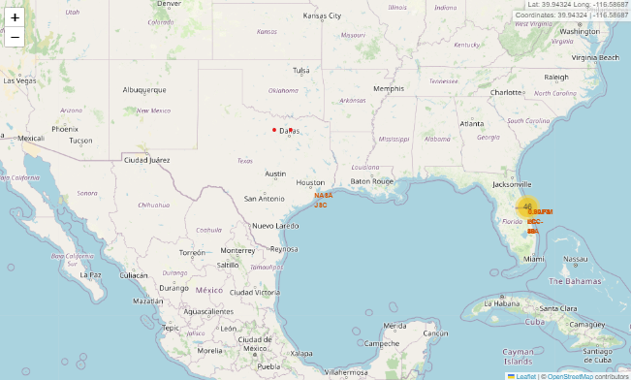
Folium (for geographic mapping and viz)
Folium is an excellent tool for plotting geographic data.
Utilizing the longitude and latitude of launch locations, we were able to visualize on a map the number of launches at each side. Additionally, we were able to (for our Florida SpaceX Launch sites) map and calculate the distance between our launch site and the nearest 1) coastline 2) highway 3) railway 4) city.

Slide 12
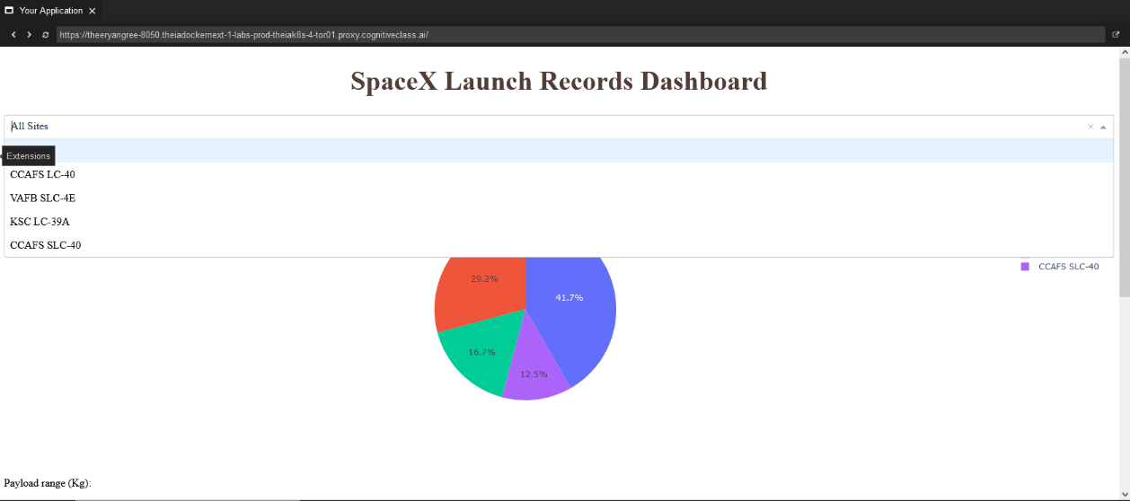
Plotly (for interactive dashboarding)
Utilizing Plotly, we created a simple, interactive dashboard.
The dashboardcontained pie charts for launches by sites, and a scatter graph for a relationship of outcome with payload mass by booster versions.

Slide 13
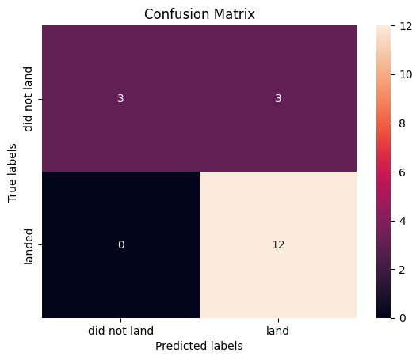
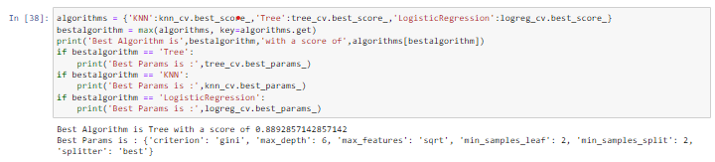
Machine Learning
At the end of our journey, we took in our data and split it into training and testing.
We utilized a variety of ML-ing algorithms and tuned them with GridSearchCV (parameters like poly, linear, rfb, and sigmoid kernels).
Storing the results by accuracy together, we were able to determine the best classification method (shown above).

Slide 14

Conclusions

Slide 15
Payload Mass and Flight Number
Given that 1s (orange) are successes, we can see that as time goes on, starting with flight 7, our successes become more successful, and with that, our payload mass also increases.

Slide 16
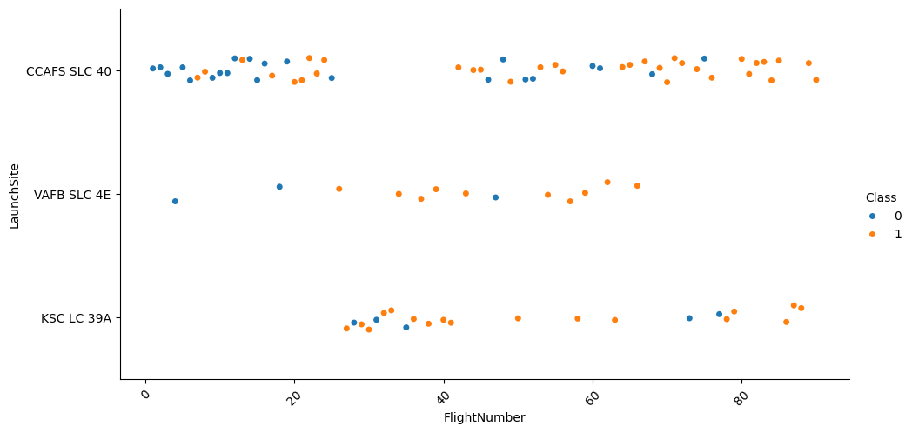
Launch Sites and Outcomes
We can see how launch sites were utilized and make assumptions about which facility is newer vs older. Their oldest launch sites, CCAFS SLC 40 did not have initial success understandably, but returned to much more frequent use and success as SpaceX launched more flights.

Slide 17
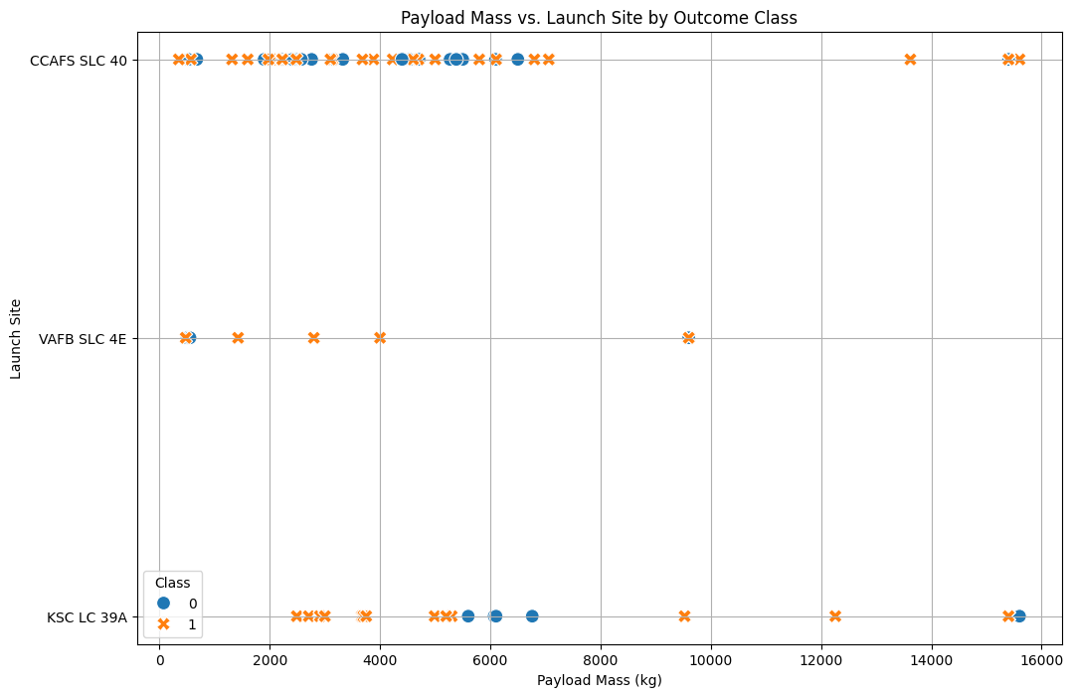
Payload Mass, Launch Sites, and Outcomes
Wutilizing the graph we can see (excluding one or two flights) that the heavier payloads demonstrate higher success. Keeping in mind that they added more weight as they conducted more flights, I think this demonstrates growing mastery in SpaceX’s endeavors.

Slide 18
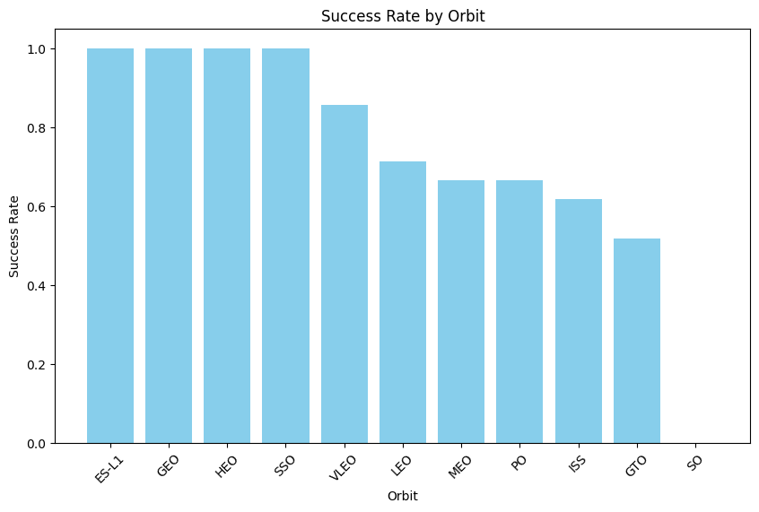
Success Rates by Orbit
ESL1: Earth-Sun Lagrange Point 1
GEO: Geostationary Orbit
HEO: Highly Elliptical Orbit
SSO: Sun-Synchronous Orbit
LEO: Low Earth Orbit
VLEO: Very Low Earth Orbit
MEO: Medium Earth Orbit
PO: Polar Orbit
ISS: International Space Station
GTO: Geostationary Transfer Orbit
SO: Suborbital
ES-L1, GEO, HEO, and SSO all have 100(ish) success rates.

Slide 19
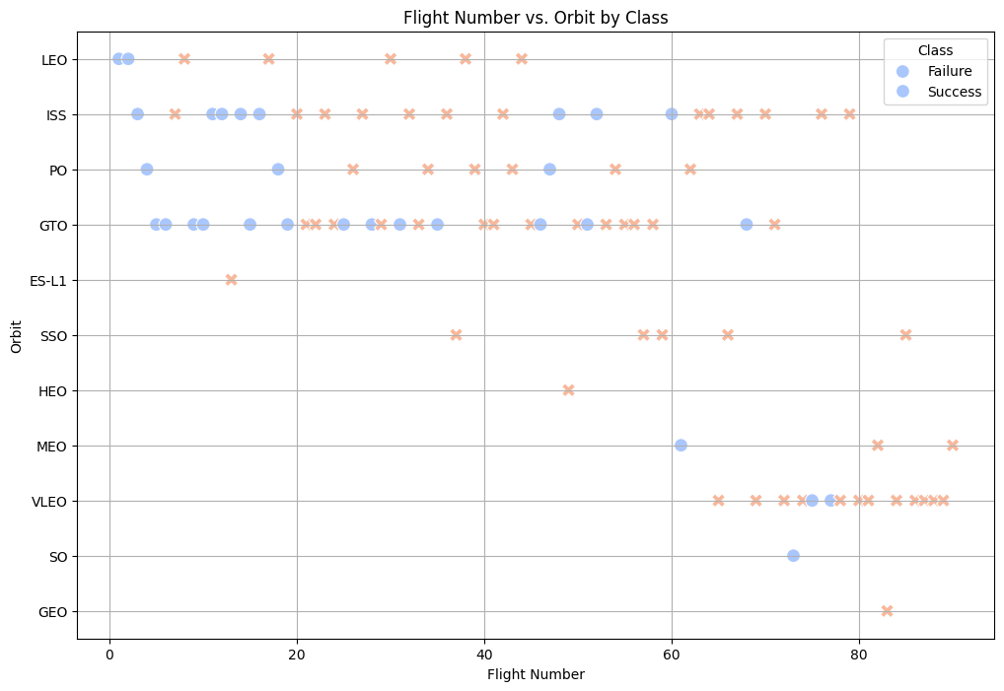
Flight Number vs Orbit by Class
Based on this graph we can see their progression for orbiting targets, as well as their outcomes. It seems typically they the more flights done with a particular orbital target, the more likely they are to succeed (understandably).

Slide 20
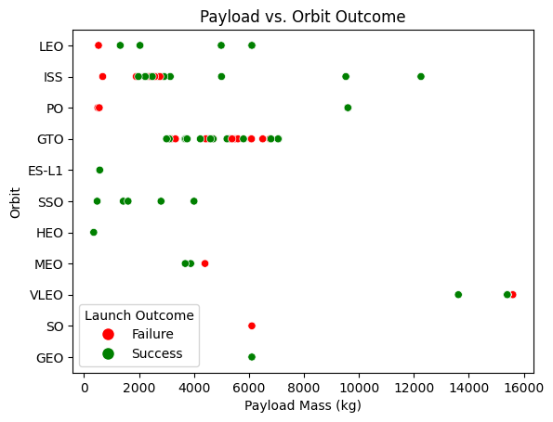
Payload vs Orbit Outcome
Across LEO, ISS, PO, and GTO, it seems typically that they operate using lower payloads, and these lower paylods typically have more chance to fail.

Slide 21
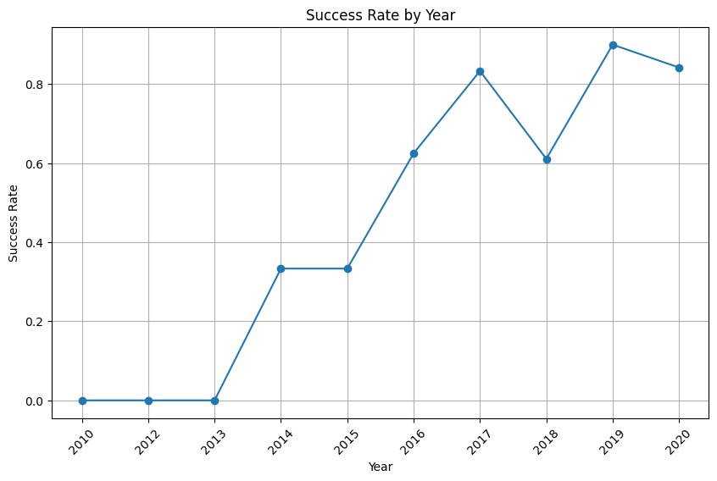
Success Rate by Year
We can see that as time went on, SpaceX’s mastery or rockets improved. That said, 2018 was a rougher year than most. One might also wonder if in 2020 that their success rate is higher because they were less rocket flights (due to Covid-19).

Slide 22
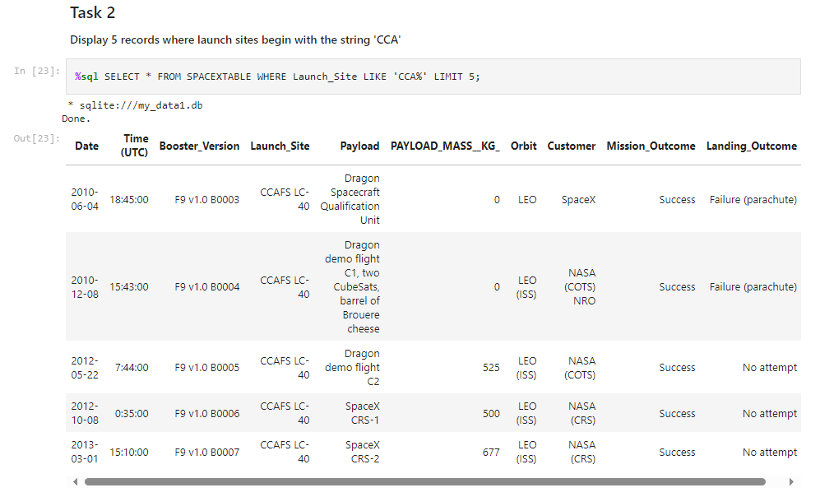
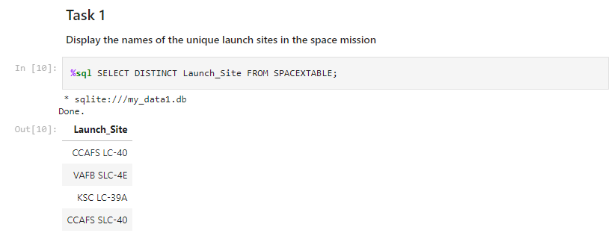
SQL EDA 1-2
Going by task, these first two tasks are to show us a little bit about the data utilizing SQL.

Slide 23
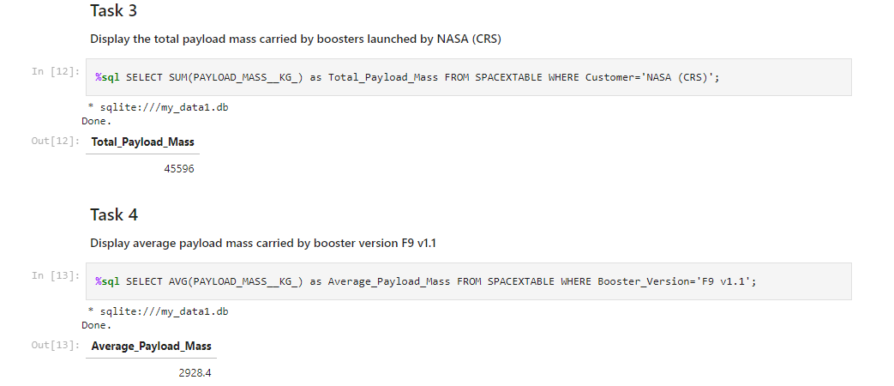
SQL EDA 3-4
We’re able to see total payload mass over all flights, as well as the average payload.

Slide 24
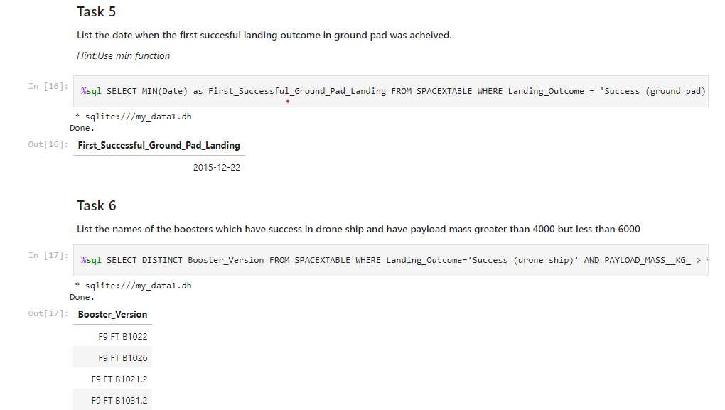
SQL EDA 5-6
These tasks demonstrate the first successful ground pad landing, and additionally, drone landing successes for payload masses more than 4,000kg, and less than 6,000kg.

Slide 25
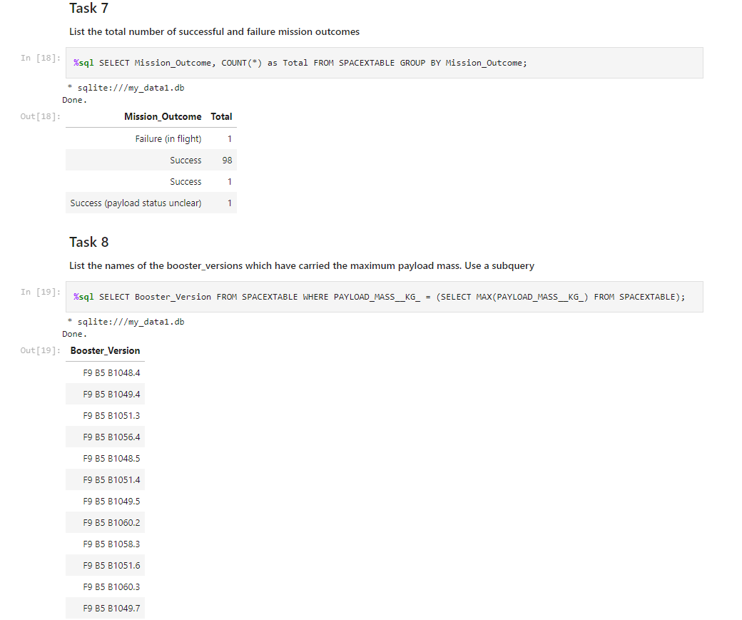
SQL EDA 7-8
We’re able to see the total mission outcomes, as well as which booster versions were able to carry the heaviest payloads (arguably making them the most powerful).

Slide 26
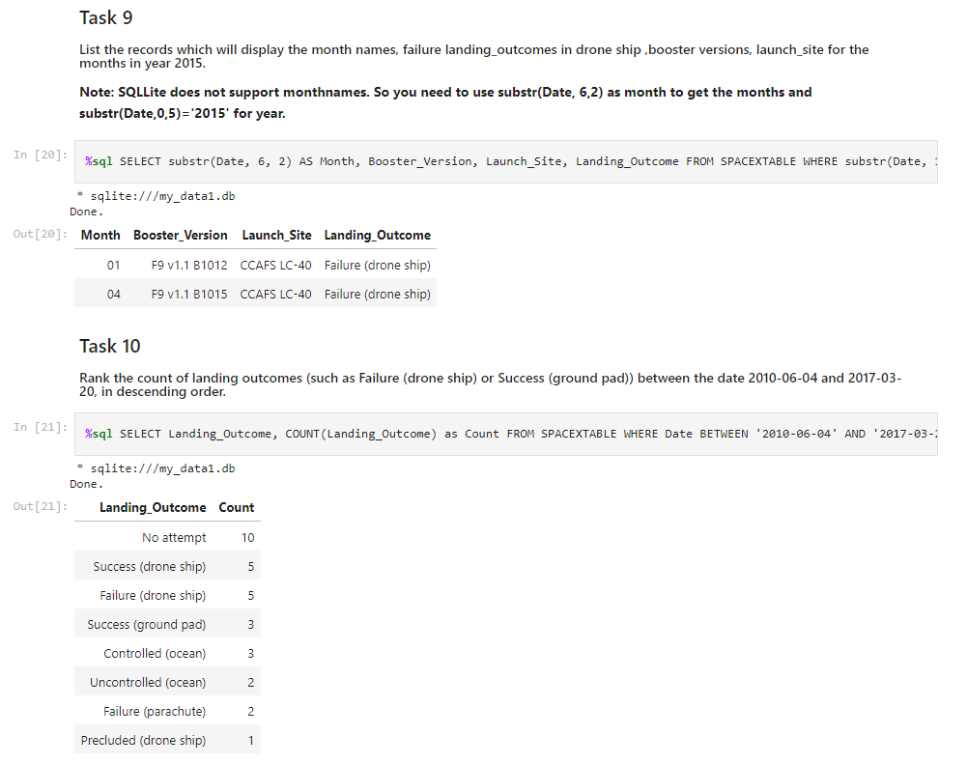
SQL EDA 9-10
Our last set of tasks show us successes and failures between some specific date ranges.

Slide 27
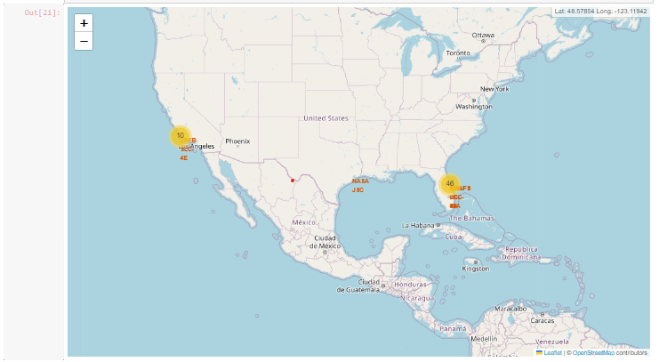
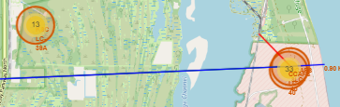
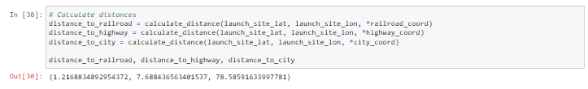
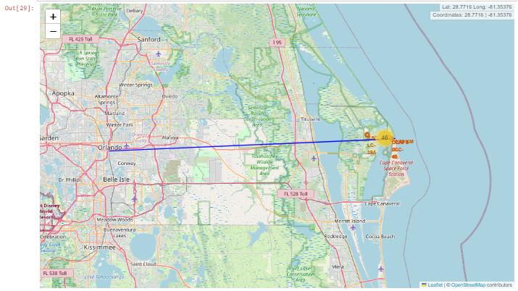
Folium & Proximity
Our folium setup is supposed to answer four main questions:
Are launch sites in close proximity to railways?
Are launch sites in close proximity to highways?
Are launch sites in close proximity to coastline?
Do launch sites keep certain distance away from cities?
Based on our findings illustrated in our maps, visualizations, and calculations: our launch site is infact close to infrastructure and the coastline, but not quite so close to the city.

Slide 28
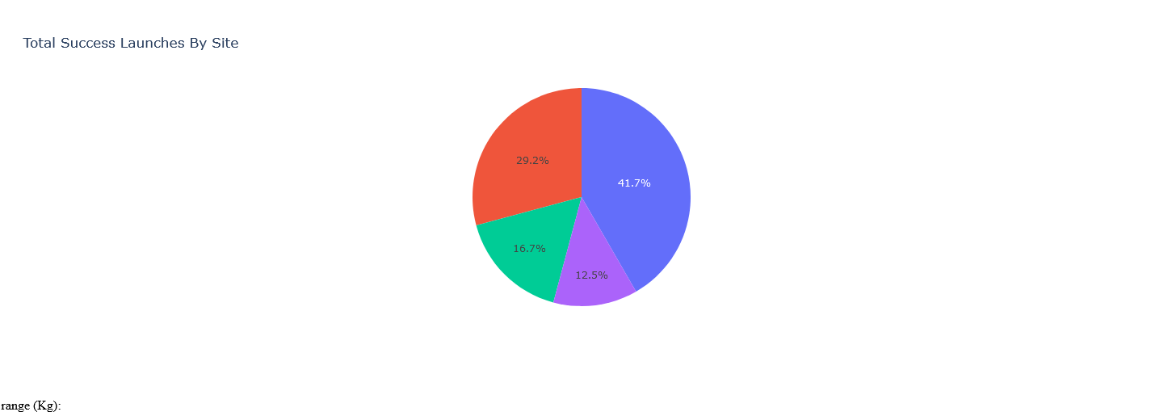
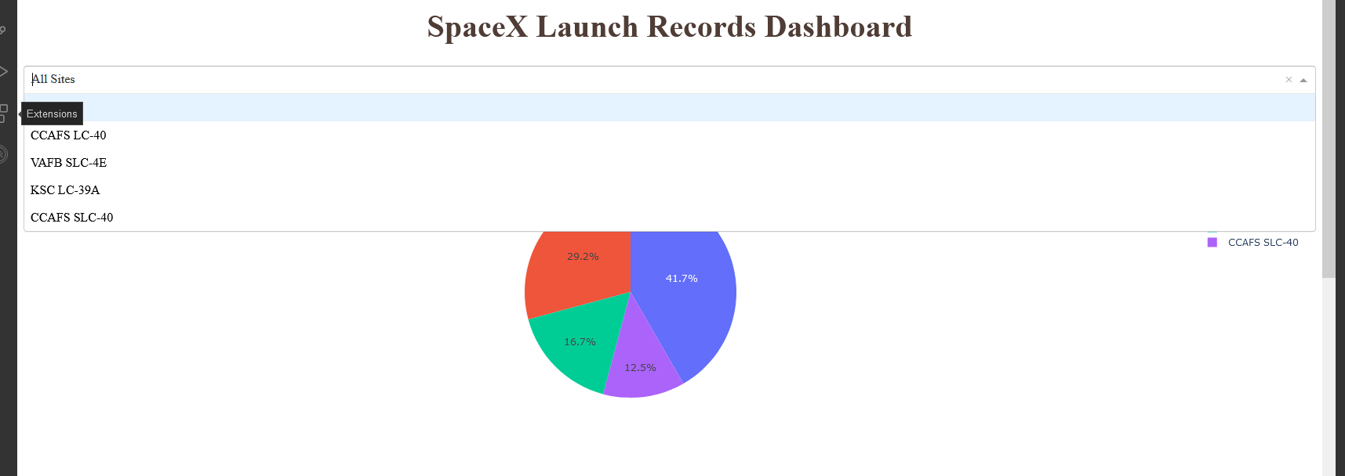
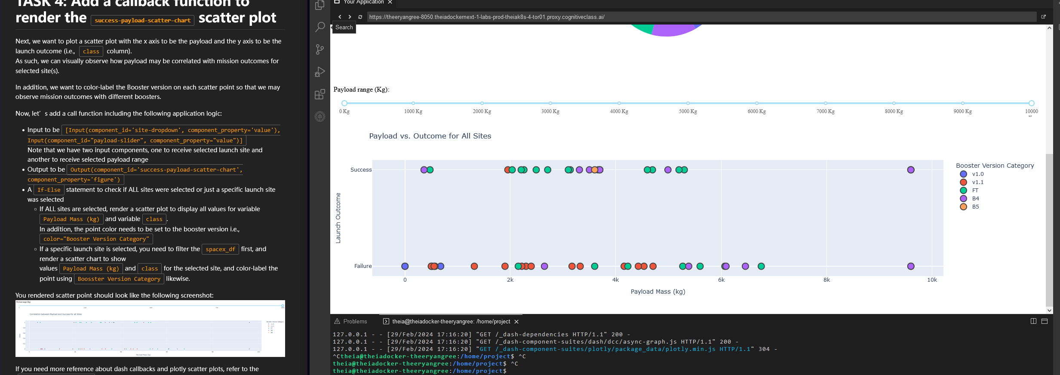
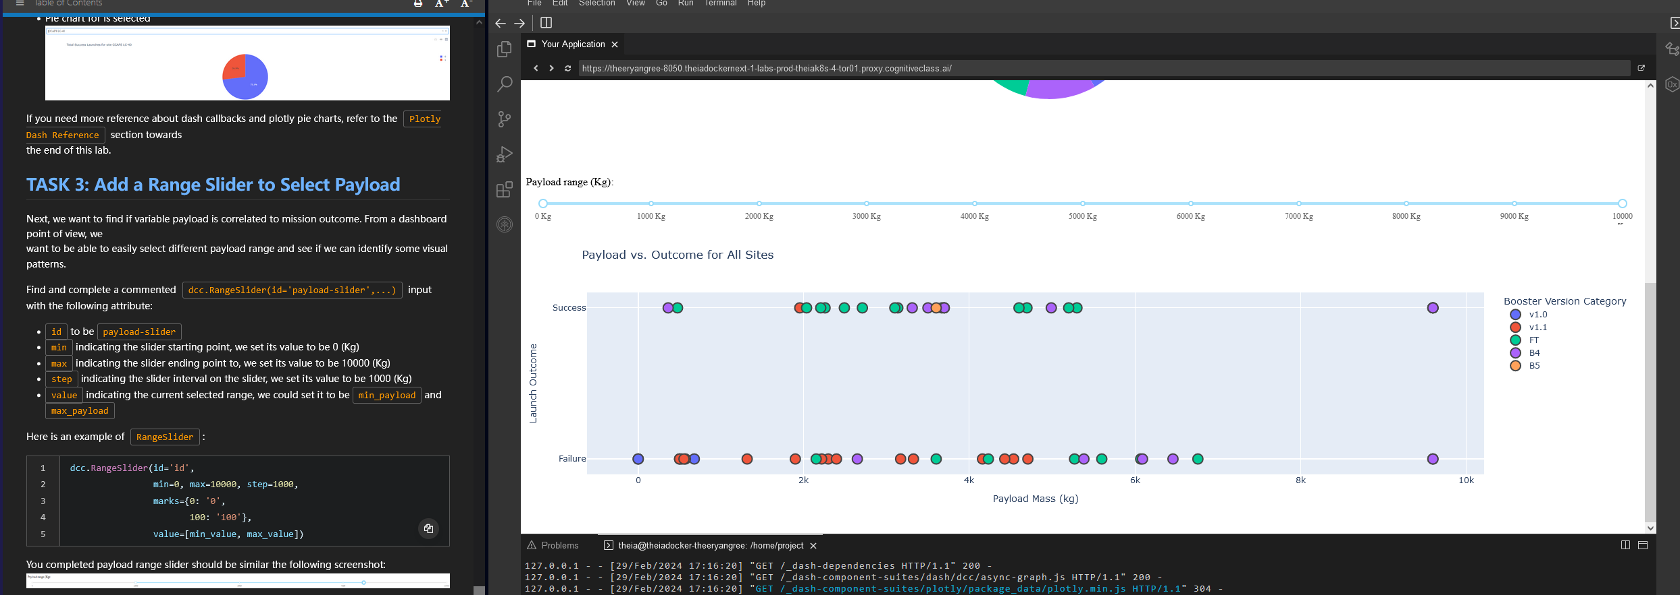
Plotly Dashboarding
Utilizing our Plotly Dashboard (which, my copy and paste would not work on), we’re able to illustrate our success rate by launch site, and additionally, see that lower weighted payloads are often more successful than heavier ones.

Slide 29
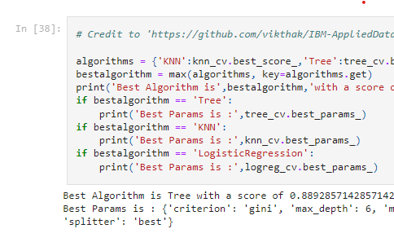
Machine Learning
As stated before in the earlier machine learning slide, our best model is the Decision Tree.
As far as our predictability goes, the confusion demonstrates that while our model works well, it does occasionally throw a false positive (crashed marked as landed).

Slide 30
Final Remarks
As time goes on, SpaceX has improved their flight capabilities, and hit their goals more consistently/often.
SpaceX is especially good at hitting it’s ES-L1, GEO, HEO, and SSO targets (100% or near 100% rates).
The data demonstrates that higher payload targets are more successful, but additionally, these flights are later. Keeping context in mind, does weight mean better flights? Or is more weight a result of time? I am inclined to believe the later.
When making predictions to hit targets: our Decision Tree algorithm will be best.

Slide 31

Thank you!

